Slide 1

Department of Computer Science and Business Systems
Project Review - 1

Slide 2
AI based smart stock selection using historical data
Team:
1. Name:Suriyakaant.S.R.
Reg. No.211722244107
2.Name:Shakthidharan .T
Reg. No.211722244095
3.Name:Mathiganth.P
Reg. No.211722244301
Supervisor Name :Mr.S.Rathna Sabapathy
Qualification:
Designation
Department of CSBS

Slide 3
Outline
Proposed Research Area
Background and Motivation
Objectives
Literature survey
Modules
Expected Results
References

Slide 4
Proposed Research Area
Stock Prediction Optimization: Applying AI to analyze historical stock price trends for improved future return predictions.
Risk-Return Balancing: Exploring how models weigh expected returns versus risks, offering smarter portfolio suggestions.
Feature Engineering from Historical Data: Using past trading volumes, price movements, and technical indicators as AI input features.
Model Comparison: Evaluating different AI approaches—like regression, decision trees, or neural networks—for selection performance.
Automated Decision Support: Creating a tool that helps investors by automatically recommending stocks based on learned patterns.

Slide 5
Background and Motivation
Process Vast Data: Use AI to analyze market data at a scale impossible for humans.
Remove Human Bias: Make objective, data-driven decisions free from emotions like fear and greed.
Boost Speed & Efficiency: Automate analysis to identify opportunities much faster than manual methods.
Find Hidden Patterns: Identify subtle, predictive signals in historical data that humans would miss.
Democratize Investing: Provide powerful, AI-driven analytical tools to everyday investors.

Slide 6
INTRODUCTION
Problem Statement: Traditional stock-picking relies heavily on human judgment; AI can add data-driven precision.
Opportunity: With large-scale historical data available, AI offers the chance to uncover patterns not visible to humans.
Goal: Develop an AI framework that suggests top-performing stocks by learning from past behavior.
Scope: Focus on a defined market (e.g., S&P 500, Indian stock exchanges) and a specific timeframe (e.g., past 5 years).
Impact: Helps investors make informed decisions quickly, potentially enhancing profitability and reducing emotional bias.

Slide 7
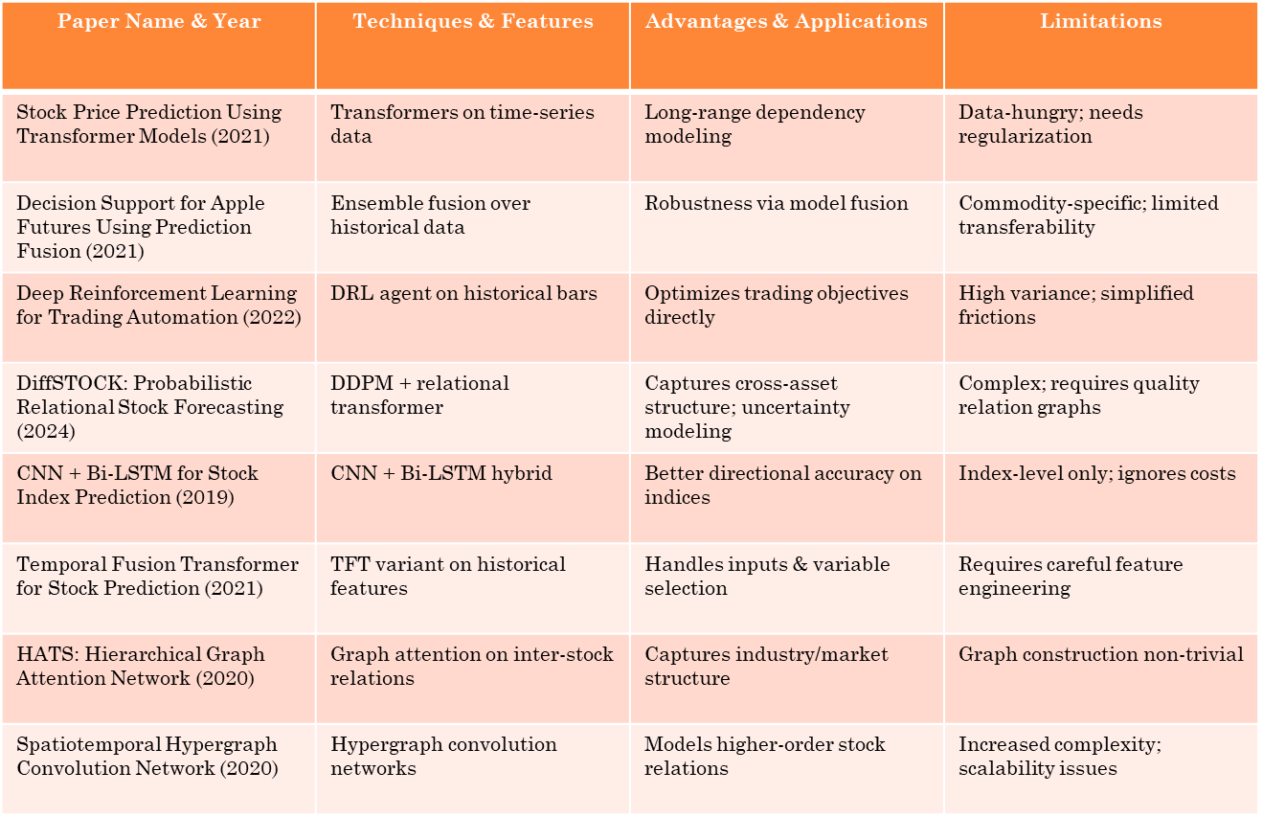
Literature Survey

Slide 8
Literature Survey
Paper Name & Year | Techniques & Features | Advantages & Applications | Limitations
9
10
11
12
13
14
15
16

Slide 9
Proposed Methodology
Data Collection: Gather historical stock data (prices, volumes, market indicators) from reputable sources (e.g., Yahoo Finance, Bloomberg).
Preprocessing: Clean the data, handle missing values, normalize scales, and engineer indicators like moving averages or RSI.
Model Selection: Train multiple AI models—such as Random Forest, LSTM Neural Networks, and Gradient Boosting—to predict stock performance.
Feature Importance Analysis: Identify which historical indicators (e.g., momentum, volatility) most influence predictions.

Slide 10
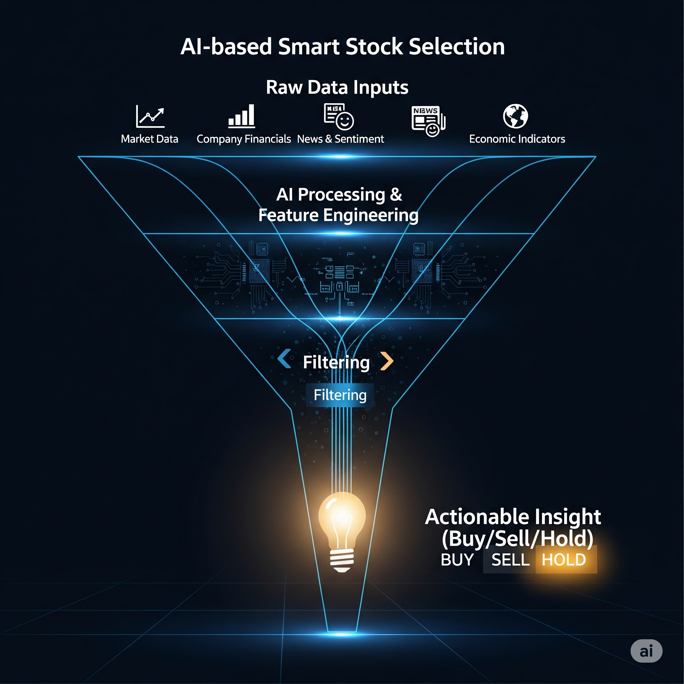
Block diagram

Slide 11
Evaluation Metrices
Accuracy of Predictions: Percentage of times the model correctly identifies outperforming vs. underperforming stocks.
Sharpe Ratio of Portfolio: Measures risk-adjusted return of the selected portfolio.
Cumulative Return: Total return over a test period compared against benchmarks like market indices.
Precision/Recall for Top Stocks: Especially useful if framing this as a classification (top-10 selection, etc.).
Statistical Significance (e.g., p-value): Determine whether observed performance improvements are reliably different from random selection.

Slide 12
Modules
Data Ingestion Module: Downloads and stores historical data from chosen sources.
Preprocessing Module: Cleans data, performs normalization, handles nulls, computes technical indicators.
Model Training Module: Implements AI algorithms, handles cross-validation, hyperparameter tuning.
Prediction & Ranking Module: Uses trained model to predict and rank stocks by expected return or other criteria.
Evaluation & Feedback Module: Calculates metrics (returns, Sharpe ratio, accuracy), compares against benchmarks, and feeds insights back into model refinement.

Slide 13
References
Fama, E.F., & French, K.R. (1993). Common Risk Factors in the Returns on Stocks and Bonds. Journal of Financial Economics.
Zhang, L., & Zhou, T. (Year). Stock Market Prediction with Artificial Neural Networks. [Journal/Conference].
Chen, K., Zhou, Y., & Dai, F. (2015). A LSTM-based Method for Stock Returns Prediction: A Case Study of China Stock Market.
Gu, S., Kelly, B., & Xiu, D. (2020). Empirical Asset Pricing via Machine Learning. The Review of Financial Studies.
Fama, E.F. (1970). Efficient Capital Markets: A Review of Theory and Empirical Work. Journal of Finance.

Slide 14
Queries?

Slide 15
Thank you...

